Slide 1

Deal Finder
A SMARAN REDDY (CS23B1011)
DEVANAND M (CS23B1020)
UNDER
DR.DUBACHARLA GYNESHWAR

Slide 2
Aim:
The aim of the Deal Finder project is to develop an automated system that compares product prices between Flipkart and Amazon, helping users find the best deals by displaying the lowest price available in real-time.
Objectives:
To create a user-friendly interface that allows users to search for products by name.
To scrape product prices from both Flipkart and Amazon using web scraping techniques.
To compare the prices and identify the lowest price for the specified product.
To provide real-time updates to users regarding the best deals available on both platforms.
To display the price, along with a link to the respective platform, enabling users to make informed purchasing decisions.
To maintain a log of product price tracking for analysis and future reference.

Slide 3



TECHNOLOGIES USED:
1.Programming Language:
Python (in pycharm)
2.Web Scraping Libraries:
BeautifulSoup
Requests
3.Web Framework:
Streamlit
4.Logging:
Python's logging module
5.Image Processing:
PIL (Python Imaging Library)
6.Browser Headers:
User-Agent rotation

Slide 4
Methodology for Deal Finder Project:
Web Scraping Setup:
requests library :HTTP requests are sent
get_page: Retrieves the HTML content
BeautifulSoup: parsed to locate the product price
clean_price Function: converts the price string into a float for comparison
track_prices Function: compares the prices
logging module: helps track successes, errors, and price comparisons for debugging
GUI:
Design:
Outline system architecture and create wireframes for the Streamlit .
Implementation:
Backend Logic Integration, Implement error handling and Highlight the lowest price and provide a link to the best deal.

Slide 5
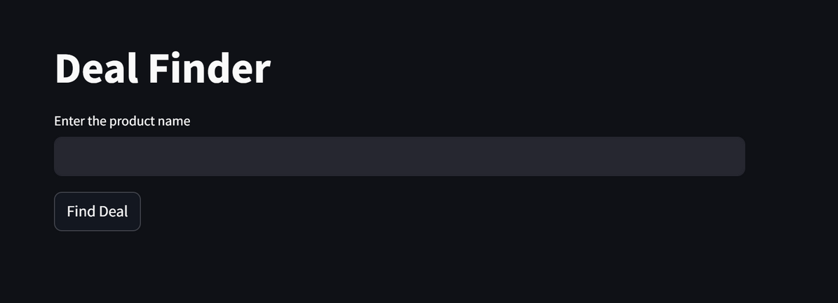
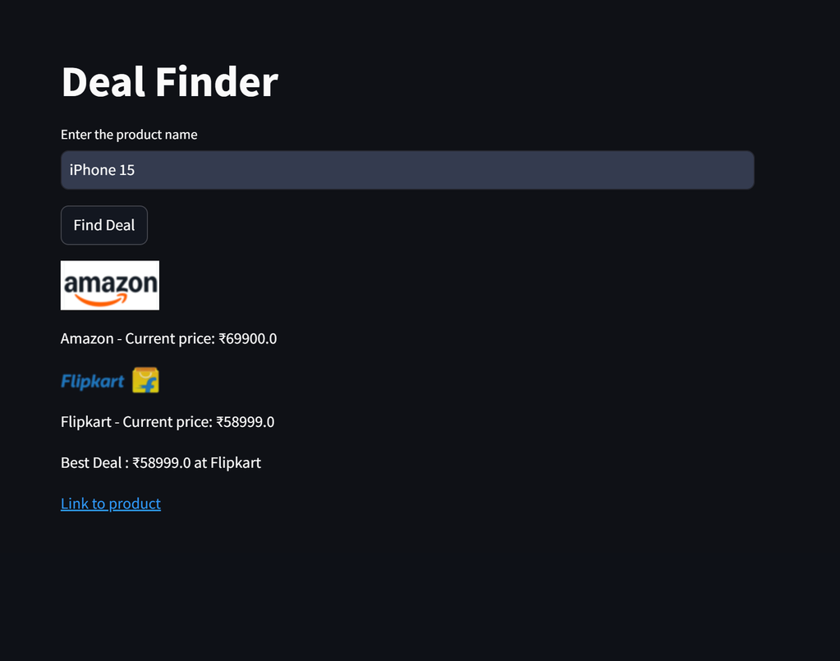
HOME PAGE: OUTPUT:

Slide 6
Thank You

